Slide 1

University of Oxford
Travel Insurance
2023 – Version 1
Narrated by Michala Davis – Insurance Assistant

Slide 2

University Travel Insurance
Benefits to you
Travel Insurance Website Navigation:
  Eligibility and how to apply for the cover
  Referrals – Types and information
  Claims – Emergency contact and claims information
  TIRS – Travel Insurance Registration System – Introduction and system screen review.
  Policy Conditions and Exclusions – Review of key points
Concluding thoughts
How to contact Insurance Team

Slide 3
Insured Benefits
Claims for any costs incurred are assessed subject to policy terms and conditions, and require evidence of loss to be provided.
Travel Assistance via Aon Protect
Insured Traveller
Post-Travel Assistance
Pre- Travel Assistance
During Trip – Assistance
Emergency Assistance Claim
Non-emergency expense claim
Non-Medical Emergency
Medical - Emergency
Travel Advice
Emergency Assistance Provider
Advice only pre-travel

Slide 4


Cost to Individual Traveller
FREE
Except in the following circumstances (where an additional premium is levied or where otherwise stated):
  High Risk Destination – Remote/FCDO recommended no travel zone
  Trade Sanction Country
  High Risk Activity being undertaken
  Infectious Disease Contagion Risk (example Ebola)
  Traveller is a member of a University club or society – Fixed fee £18 per person
  Local Department charges a fee

Slide 5
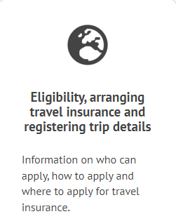
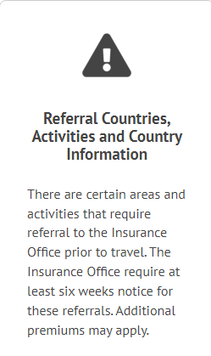
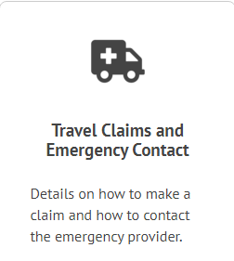
Travel Insurance Website – Navigation 1 of 2
Front Page
  https://finance.admin.ox.ac.uk/travel-insurance

Slide 6
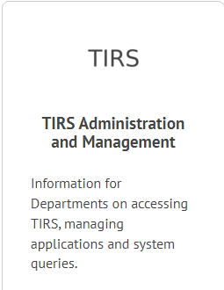
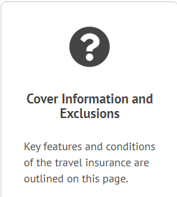
Travel Insurance Website – Navigation 2 of 2
More about the Front Page
  Travel Insurance Updates
  Links to other areas of the site

Slide 7
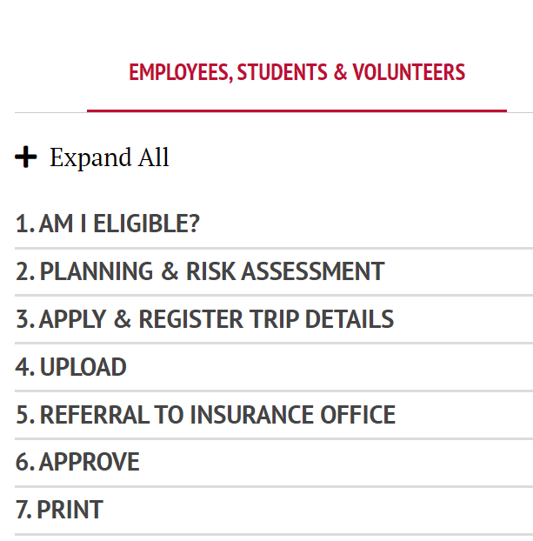
Eligibility Section

Slide 8
Referral Section
Categories of referral:
High Risk Countries
Trade Sanctioned Countries
High Risk Activities and Winter Sports
Other Resources:
Country Information

Slide 9
Insurance Referral – High Risk Countries
The following are high risk countries/areas and require referral to the insurer in order to arrange cover.
In alphabetical order:
Afghanistan
Antarctica
Central African Republic
Iraq
Libya
Mali
Russia (including Crimea)
Somalia
South Sudan
Syria
Ukraine
Yemen
Any other territory where there are current cases of Ebola, the World Health Organisation can be used as a source of information with regards to the Ebola Pandemic.
Note – The Risk Assessment can be uploaded to TIRS but applications need to be referred to the Insurance Team with a minimum of 6 weeks’ notice. An additional premium will also apply if cover is given.
Notes:
I will explain TIRS in more depth later on in the session
Subject to change

Slide 10
Insurance Referral - Trade Sanctions
The following are countries with trade sanctions and require referral to the insurer in order to arrange cover.
In Alphabetical Order:
Cuba
Iran
North Korea
Russia (including Crimea)
Sudan
Syria
Ukraine
Please note that in some circumstances trip duration limits (max 60 days) and/or additional premiums may also apply.
Note – The Risk Assessment can be uploaded to TIRS along with the Trade Sanctions Questionnaire (system will prompt this) but please refer applications to the insurance team with a minimum of 6 weeks’ notice so referral can be made.

Slide 11
Trade Sanctions Questionnaire
Details of the trip (dates, names etc)
Details of the work to be carried out
Location of the work
Companies being visited
Details of any government agency, private company or aid agency being visited
Details of security guards or army personnel accompanying traveller
Where the traveller is staying
Nationality of traveller
Annual salary of traveller
Cover is now being refused for certain trips – early notification is therefore crucial

Slide 12
Insurance Referral – High Risk Activities
The following are high risk activities, and winter sports which require referral to the Insurance Office in order to arrange cover:
Aviation Risks/Piloting/Aircrew
Diving (below 30 metres depth)
All sub sea work
Off Shore Activities, Trawler men/women, Fish Farming, Merchant Shipping and Ships Crews
Mining Risks
Police/Fire/Ambulance services
Foresters/Sawmills/Tree Surgeons
Abattoirs and Slaughter Houses
Travellers over the age of 80 (cover restrictions may apply)
Travellers participating in dangerous/winter sports
Additional premiums may also apply.
https://finance.admin.ox.ac.uk/referral-countries-and-activities
Notes:
If you are unsure whether anything is high risk – please ask.

Slide 13
Country Information
Where to find additional country information?
The Foreign, Commonwealth and Development Office (FCDO) website should be consulted for additional country information.
For further country information and daily email updates, visit https://my.worldaware.com/affiliates/aonprotect/ - the password for the website is the last four digits of the emergency contact telephone number: +44 (0) 20 7173 7797
Country information is available to travellers from the Assistance Provider website: https://www.chubb.com/uk-en/assistance-services/aonprotect-assistance.html
Notes:
These details are on the travel website under country info

Slide 14
Claims Section
Travel Claims and Emergency Contact Info:
Claims submission deadlines and guidance on terms and conditions for:
  Contacting emergency assistance provider
  Submitting a claim
  Policy excess
  Settlement terms
Claims Forms and Summary of Cover
https://finance.admin.ox.ac.uk/travel-claims-and-emergency-contact

Slide 15
Claims Section – Key Points
In the event of an emergency, contact the emergency provider (note they do not advise on cover)
Claims must be notified to the Insurance Office and your department within 28 days of the incident.
Supporting documentation required for every claim.
In the first instance, the traveller must check if they can recover any costs from their travel provider (Airline/Rail company).
A £50 excess is payable on each and every claim. If you are travelling for 12 months or more the excess is £100
Claims are rejected if insurance policy T&Cs and/or University policies are not followed
Always contact the Insurance Office with any queries

Slide 16
TIRS Section
Travel Insurance Registration System (TIRS)
What is TIRS
How to access for:
  Travellers
  Departmental Travel Administrators and/or Managers
User Guides and Help
Notes:
The page
New system brought in between June - September 2018 to apply for travel insurance
Allows users to create all applications and track their progress 24/7
Departmental Administrators and Managers can view & approve travel requests and see all documents on one page
Provides system generated emails to confirm when the cover has been granted
Prompts Risk Assessments & Questionnaires
Allows us to run reports to see where students are (even if they’re not using University Insurance)
Step by step user guides are available on the website
Can apply on behalf of someone else

Slide 17
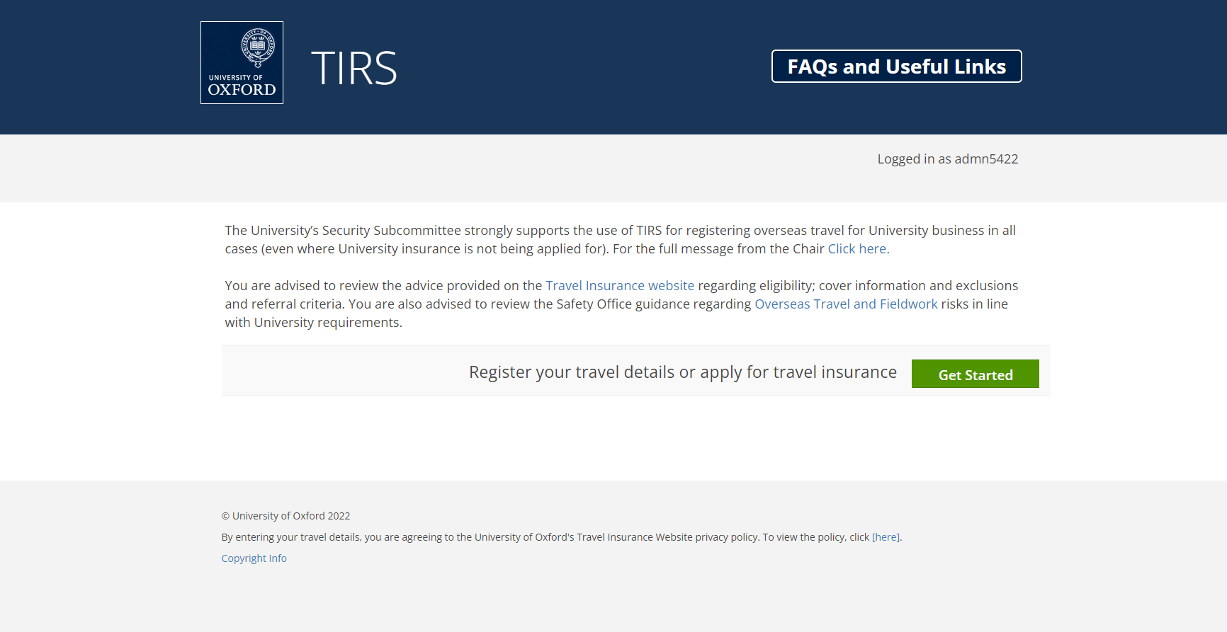
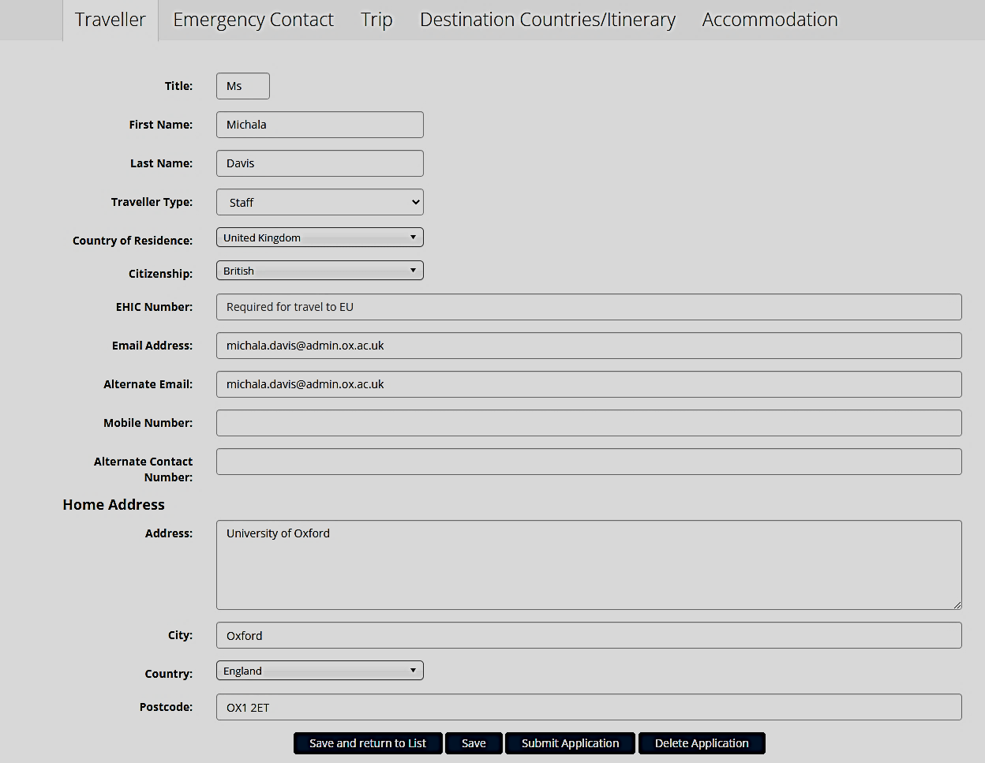
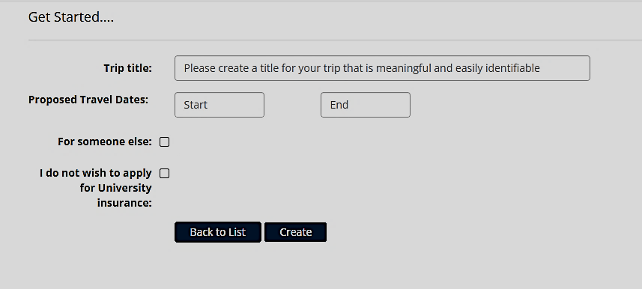
TIRS - Travel Insurance Registration System

Slide 18
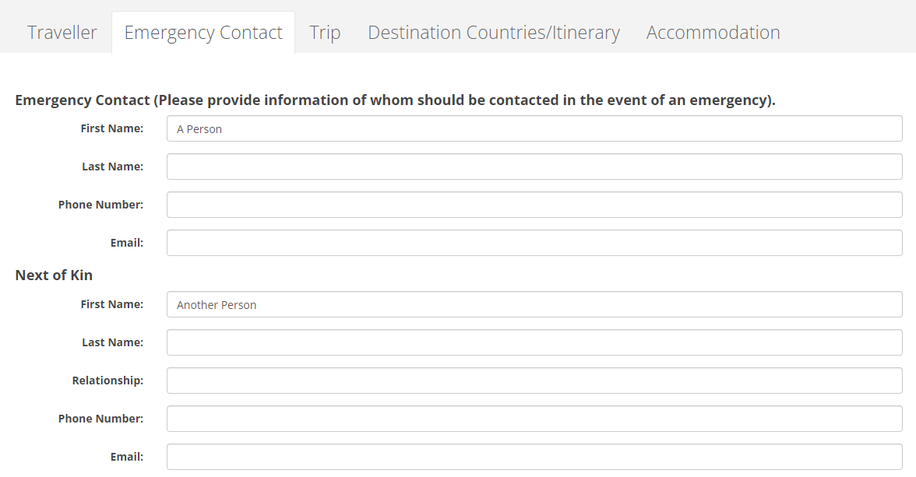
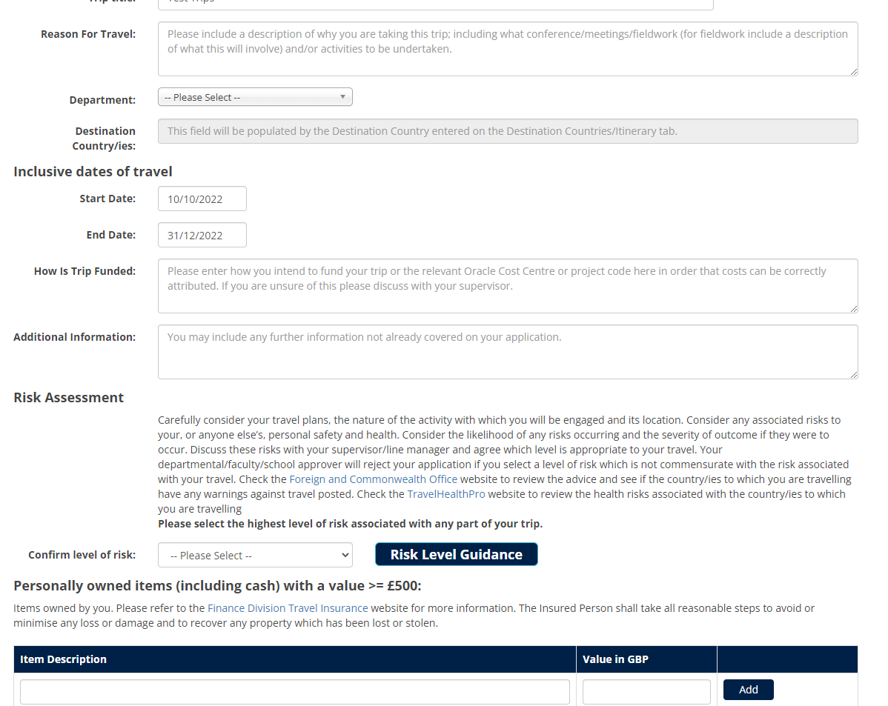
TIRS - Travel Insurance Registration System
Notes:
The page
New system brought in between June - September 2018 to apply for travel insurance
Allows users to create all applications and track their progress 24/7
Departmental Administrators and Managers can view & approve travel requests and see all documents on one page
Provides system generated emails to confirm when the cover has been granted
Prompts Risk Assessments & Questionnaires
Allows us to run reports to see where students are (even if they’re not using University Insurance)
Step by step user guides are available on the website
Can apply on behalf of someone else

Slide 19
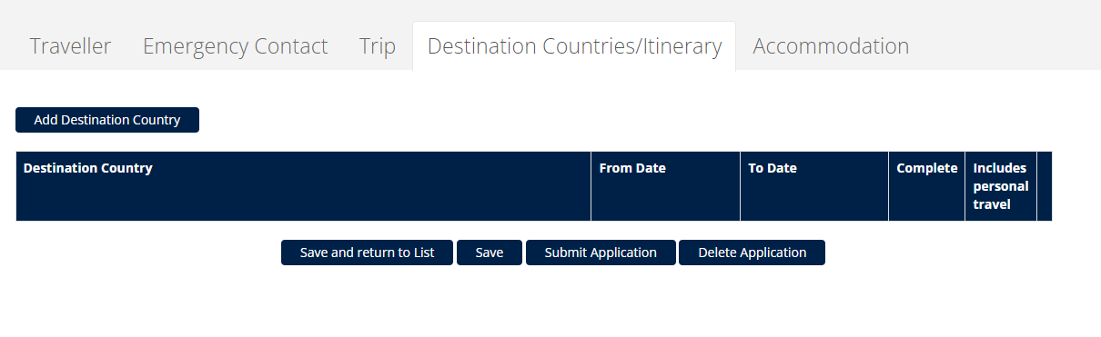
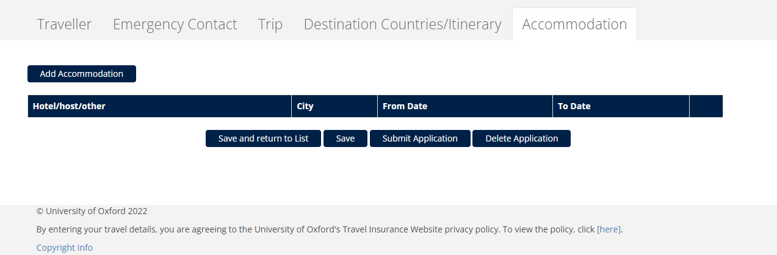
TIRS - Travel Insurance Registration System
Options to Save, Submit or Delete
Notes:
The page
New system brought in between June - September 2018 to apply for travel insurance
Allows users to create all applications and track their progress 24/7
Departmental Administrators and Managers can view & approve travel requests and see all documents on one page
Provides system generated emails to confirm when the cover has been granted
Prompts Risk Assessments & Questionnaires
Allows us to run reports to see where students are (even if they’re not using University Insurance)
Step by step user guides are available on the website
Can apply on behalf of someone else

Slide 20
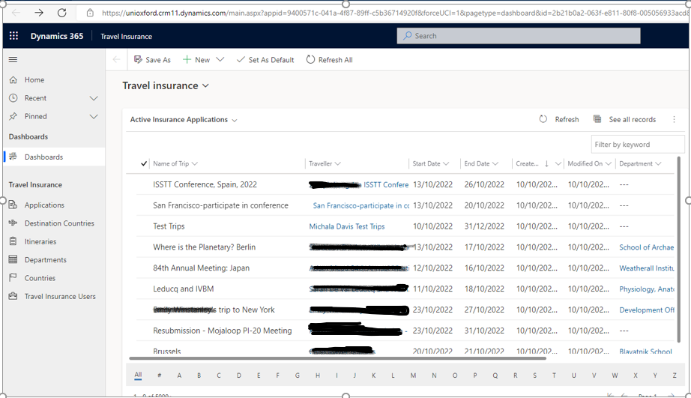
TIRS - Travel Insurance Registration System
Application on Screen
Travel Administrator/Manager reviews submitted form and then selects option from Process Management to Approve, Refer or return application to traveller if more information is required.
Notes:
The page
New system brought in between June - September 2018 to apply for travel insurance
Allows users to create all applications and track their progress 24/7
Departmental Administrators and Managers can view & approve travel requests and see all documents on one page
Provides system generated emails to confirm when the cover has been granted
Prompts Risk Assessments & Questionnaires
Allows us to run reports to see where students are (even if they’re not using University Insurance)
Step by step user guides are available on the website
Can apply on behalf of someone else

Slide 21
Cover Information Section
Conditions of Travel Insurance
Exclusions
Waivers and Indemnities

Slide 22
Key Conditions of Travel Insurance Cover
All travellers must:
  Have the appropriate entry visa/s and paperwork for the country they are intending to travel to.
  Be medically fit to travel.
  Comply with University Policies and Procedures:
    Apply for travel insurance via TIRS system and ensure application is approved before travel commences
    Comply with policies set by your own Department and other Departments within University – i.e. Safety Office, Finance, HR, Sanctions.
    Take all reasonable steps to avoid or minimise any loss or damage to themselves and their property whilst on the travel trip, and to recover any property lost or stolen.
  Note and adhere to Insurance Policy Terms and Conditions
Notes:
Pre-existing conditions – must get a Dr’s note certifying fitness to travel.

Slide 23
Travel Insurance – Other Policy conditions
University Business Only – Holiday/Personal time to be separately insured.
Cover applies for travel within UK if overnight stay involved and all travel outside UK (worldwide) – noting referral countries.
Cash cover needs to be applied for.
Home country restrictions apply.
Personal Items– all items valued at £500 and above need to be listed for each trip.
If in doubt - Ask

Slide 24
Exclusions of Travel Insurance Cover
Covid 19 exclusion (Cancellation) removed for 2022/23
  Travellers should still mitigate risks via flexible bookings.
New group travel clause – Cancellation claims.
  Applicable to bookings with 10 or more persons attending an insured event (includes conferences/training courses/research and fieldwork trips).
Personal Travel
Cover for family members
Travel against medical advice
Routine health checks, vaccinations and/or any expenses recoverable from private medical insurance policy
Departmental Contents
When travelling to home country – emergency repatriation, cancellation cover and medical expenses (where traveller eligible for state healthcare).
Disinclination to travel.
Notes:
You must apply for travel documents such as Visas in plenty of time, and also apply for your university travel insurance in plenty of time in case your are travelling to a country that is higher risk and or undertaking an activity that is higher risk which may require referral to Safety Office and Senior members of your faculty to review the risk of your trip going ahead with a decision being made on that before the trip can be referred to insurers.
This may delay your intended dates of travel so you will need to plan accordingly.

Slide 25
Waivers & Indemnities
Waivers or indemnities usually require those signing to agree to discharge the other party from all liabilities
We DO NOT recommend travellers agree to sign waivers or indemnities
Such waivers or indemnities may not permitted in English Law
They may invalidate the University’s Insurance policies
If there is no alternative they must be referred to the Insurance Office along with a detailed and approved risk assessment for consideration
Travellers must be fully aware that they are waiving any right they may
have to pursue a claim against the other party in the event that they
suffer an injury

Slide 26
Conclusion
University Insurance is free for University Business Use only. unless exceptional circumstances apply where additional premium or fee is levied.
Fieldwork – is classed as business use – subject to suitable and sufficient risk assessment and Department permission.
Planning & preparation is essential - Insurance is not a replacement for sound risk management.
  Cover is not automatic you must apply in advance via the on line system TIRS - We recommend cover is taken out as soon as travel arrangements are booked and costs incurred so that the cancellation element of the policy operates.
  Review our website for sections on Eligibility, Referrals, Claims, TIRS and Policy Cover.
  Mitigate the likelihood/risk of cancellation where possible with flexible bookings.
  Travel Insurance is there to deal with the unexpected not the everyday. Should you need additional health or personal trip travel insurance at some stage during your fieldwork trip, you will need to purchase this separately.

Slide 27
Contact Us
University Insurance Intranet site:
https://finance.admin.ox.ac.uk/travel-insurance#/
Insurance Department Contacts:
Insurance General E-mail Inbox:
insurance@admin.ox.ac.uk
Michala Davis, Insurance Assistant, 01865 616078
michala.davis@admin.ox.ac.uk
Jack Frowde, Insurance Officer, 01865 616012
jack.frowde@admin.ox.ac.uk
Lyndie Hayes, Head of Insurance, 01865 616135
lyndie.hayes@admin.ox.ac.uk

